Slide 1
Stacks
© 2013 Goodrich, Tamassia, Goldwasser
Stacks

Slide 2
Abstract Data Types (ADTs)
An abstract data type (ADT) is an abstraction of a data structure
An ADT specifies:
  Data stored
  Operations on the data
  Error conditions associated with operations
Example: ADT modeling a simple stock trading system
  The data stored are buy/sell orders
  The operations supported are
    order buy(stock, shares, price)
    order sell(stock, shares, price)
    void cancel(order)
  Error conditions:
    Buy/sell a nonexistent stock
    Cancel a nonexistent order
© 2013 Goodrich, Tamassia, Goldwasser
Stacks

Slide 3

The Stack ADT
The Stack ADT stores arbitrary objects
Insertions and deletions follow the last-in first-out scheme
Think of a spring-loaded plate dispenser
Main stack operations:
  push(object): inserts an element
  object pop(): removes and returns the last inserted element
Auxiliary stack operations:
  object top(): returns the last inserted element without removing it
  integer len(): returns the number of elements stored
  boolean is_empty(): indicates whether no elements are stored
© 2013 Goodrich, Tamassia, Goldwasser
Stacks

Slide 4
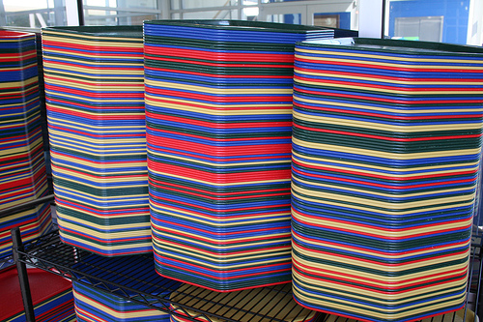
Stacks
Last In First Out (LIFO)
  Remove the most recently added item
  Analogy: cafeteria trays

Slide 5
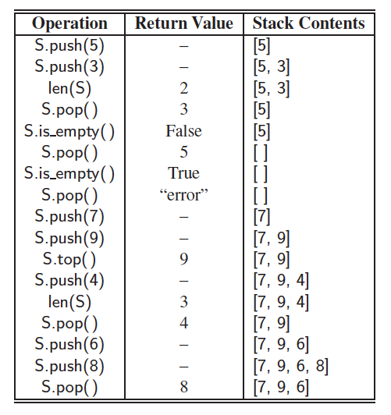
Example
© 2013 Goodrich, Tamassia, Goldwasser
Stacks

Slide 6
Stack in Action
Visualization time
  http://www.cs.usfca.edu/~galles/visualization/StackArray.html

Slide 7
Applications of Stacks
Direct applications
  Page-visited history in a Web browser
  Undo sequence in a text editor
  Chain of method calls in a language that supports recursion
  Parsing in a compiler
Indirect applications
  Auxiliary data structure for algorithms
  Component of other data structures
© 2013 Goodrich, Tamassia, Goldwasser
Stacks

Slide 8
Array-based Stack
A simple way of implementing the Stack ADT uses an array
We add elements from left to right
A variable keeps track of the index of the top element
…
S
0
1
2
t
© 2013 Goodrich, Tamassia, Goldwasser
Stacks

Slide 9
Array-based Stack (cont.)
The array storing the stack elements may become full
A push operation will then need to grow the array and copy all the elements over.
…
S
0
1
2
t
© 2013 Goodrich, Tamassia, Goldwasser
Stacks

Slide 10
Let’s Implement a simple Stack using Python’s List Class
Open array_stack_students.py
Fill in the #to do part to implement a stack
We will implement ArrayStack Class.
© 2013 Goodrich, Tamassia, Goldwasser
Stacks

Slide 11
Performance and Limitations
Performance
  Let n be the number of elements in the stack
  The space used is O(n)
  Each operation runs in time O(1) (amortized in the case of a push)
© 2013 Goodrich, Tamassia, Goldwasser
Stacks

Slide 12
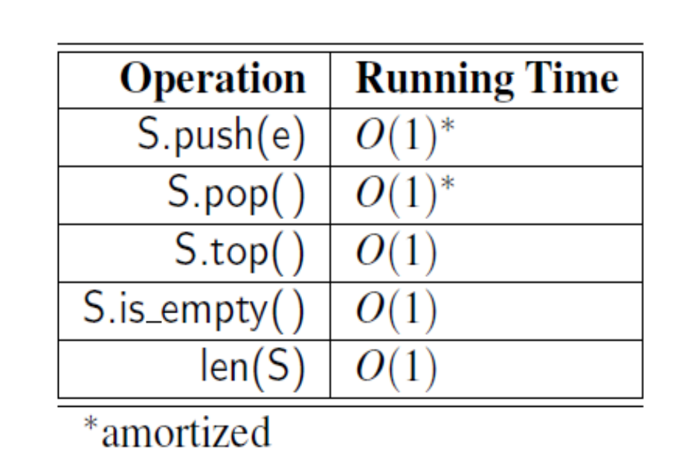
Analyzing the Array-Based Stack
© 2013 Goodrich, Tamassia, Goldwasser
Stacks

Slide 13
Let’s use our simple Stack to reverse a file
Open reverse_file_students.py
Fill in the #to do part to reverse the file contents of DSSyllabus.txt file.
We will use ArrayStack Class from array_stack_students.py file.
© 2013 Goodrich, Tamassia, Goldwasser
Stacks

Slide 14
Parentheses Matching (Application of Stack)
Each “(”, “{”, or “[” must be paired with a matching “)”, “}”, or “[”
  correct: ( )(( )){([( )])}
  correct: ((( )(( )){([( )])}
  incorrect: )(( )){([( )])}
  incorrect: ({[ ])}
  incorrect: (
© 2013 Goodrich, Tamassia, Goldwasser
Stacks

Slide 15
Parentheses Matching Algorithm
Algorithm ParenMatch(X,n):
Input: An array X of n tokens, each of which is either a grouping symbol, a
variable, an arithmetic operator, or a number
Output: true if and only if all the grouping symbols in X match
Let S be an empty stack
for i=0 to n-1 do
if X[i] is an opening grouping symbol then
S.push(X[i])
else if X[i] is a closing grouping symbol then
if S.is_empty() then
return false {nothing to match with}
if S.pop() does not match the type of X[i] then
return false {wrong type}
if S.isEmpty() then
return true {every symbol matched}
else return false {some symbols were never matched}
© 2013 Goodrich, Tamassia, Goldwasser
Stacks

Slide 16
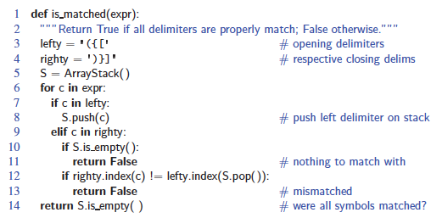
Parentheses Matching in Python
© 2013 Goodrich, Tamassia, Goldwasser
Stacks

Slide 17
HTML Tag Matching (Application of Stack)
For fully-correct HTML, each <name> should pair with a matching </name>
<body>
<center>
<h1> The Little Boat </h1>
</center>
<p> The storm tossed the little
boat like a cheap sneaker in an
old washing machine. The three
drunken fishermen were used to
such treatment, of course, but
not the tree salesman, who even as
a stowaway now felt that he
had overpaid for the voyage. </p>
<ol>
<li> Will the salesman die? </li>
<li> What color is the boat? </li>
<li> And what about Naomi? </li>
</ol>
</body>
The Little Boat
The storm tossed the little boat
like a cheap sneaker in an old
washing machine. The three
drunken fishermen were used to
such treatment, of course, but not
the tree salesman, who even as
a stowaway now felt that he had
overpaid for the voyage.
1. Will the salesman die?
2. What color is the boat?
3. And what about Naomi?
© 2013 Goodrich, Tamassia, Goldwasser
Stacks

Slide 18
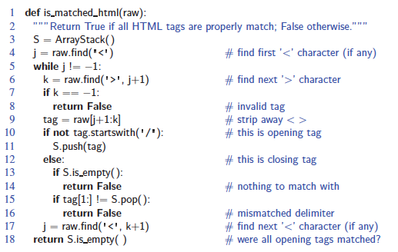
Tag Matching Algorithm in Python
© 2013 Goodrich, Tamassia, Goldwasser
Stacks

Slide 19
Evaluating Arithmetic
Expressions
Slide by Matt Stallmann included with permission.
14 – 3 * 2 + 7 = (14 – (3 * 2) ) + 7
Operator precedence
* has precedence over +/–
Associativity
operators of the same precedence group
evaluated from left to right
Example: (x – y) + z rather than x – (y + z)
Idea: push each operator on the stack, but first pop and perform higher and equal precedence operations.
© 2013 Goodrich, Tamassia, Goldwasser
Stacks

Slide 20
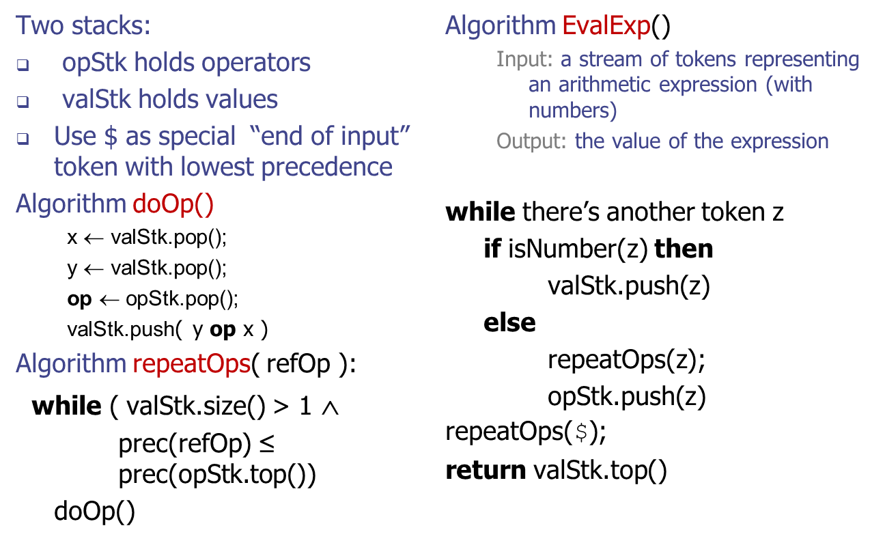
Algorithm for
Evaluating Expressions
Slide by Matt Stallmann included with permission.
© 2013 Goodrich, Tamassia, Goldwasser
Stacks

Slide 21
Algorithm on an
Example Expression
Slide by Matt Stallmann included with permission.
Operator ≤ has lower precedence than +/–
14 ≤ 4 – 3 * 2 + 7
4
–
14
≤
3
*
$
$
4
–
7
$
14
≤
F
+
-2
+
5
+
14
≤
14
≤
2
2
3
*
3
*
6
4
–
4
–
4
–
-2
+
14
≤
14
≤
14
≤
14
≤
© 2013 Goodrich, Tamassia, Goldwasser
Stacks

Slide 22
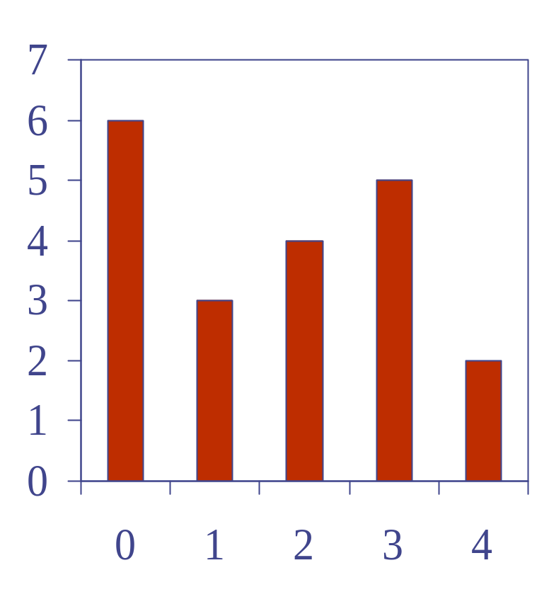
Computing Spans (not in book)
Using a stack as an auxiliary data structure in an algorithm
Given an an array X, the span S[i] of X[i] is the maximum number of consecutive elements X[j] immediately preceding X[i] and such that X[j] ≤ X[i]
Spans have applications to financial analysis
  E.g., stock at 52-week high
X
6 | 3 | 4 | 5 | 2
1 | 1 | 2 | 3 | 1
S
© 2013 Goodrich, Tamassia, Goldwasser
Stacks

Slide 23
Quadratic Algorithm
Algorithm spans1(X, n)
Input array X of n integers
Output array S of spans of X #
S ← new array of n integers n
for i ← 0 to n − 1 do n
s ← 1 n
while s ≤ i ∧ X[i − s] ≤ X[i] 1 + 2 + …+ (n − 1)
s ← s + 1 1 + 2 + …+ (n − 1)
S[i] ← s n
return S 1
Algorithm spans1 runs in O(n²) time
© 2013 Goodrich, Tamassia, Goldwasser
Stacks

Slide 24
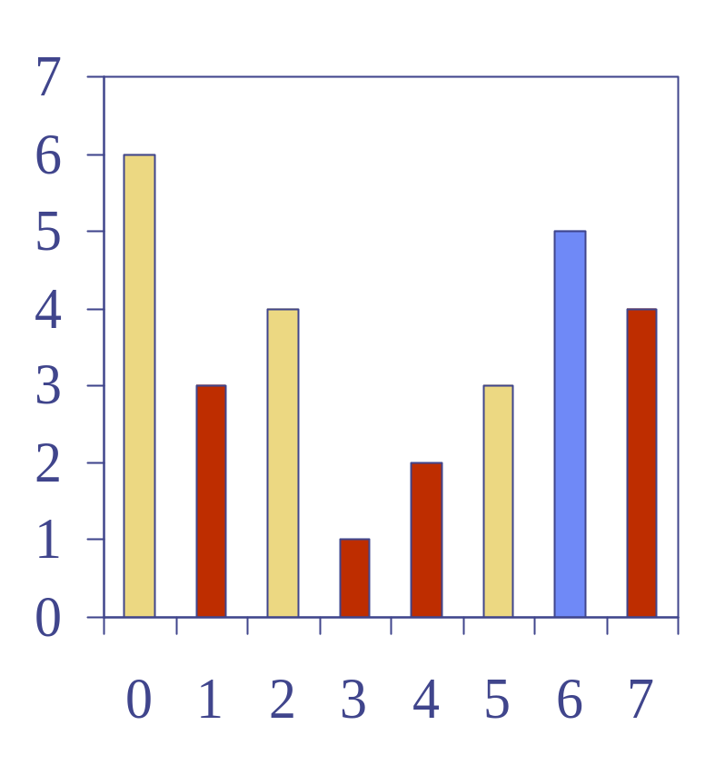
Computing Spans with a Stack
We keep in a stack the indices of the elements visible when “looking back”
We scan the array from left to right
  Let i be the current index
  We pop indices from the stack until we find index j such that X[i] < X[j]
  We set S[i] ← i − j
  We push x onto the stack
© 2013 Goodrich, Tamassia, Goldwasser
Stacks

Slide 25
Linear Algorithm
Each index of the array
  Is pushed into the stack exactly one
  Is popped from the stack at most once
The statements in the while-loop are executed at most n times
Algorithm spans2 runs in O(n) time
Algorithm spans2(X, n) #
S ← new array of n integers n
A ← new empty stack 1
for i ← 0 to n − 1 do n
while (¬A.is_empty() ∧
X[A.top()] ≤ X[i] ) do n
A.pop() n
if A.is_empty() then n
S[i] ← i + 1 n
else
S[i] ← i − A.top() n
A.push(i) n
return S 1
© 2013 Goodrich, Tamassia, Goldwasser
Stacks

